Slide 1
We will begin shortly…

Slide 2
Schdule
Story – Mask detection using CNNs (10:20 AM)
What are Neural Networks? (10:50 AM)
Types of Computer vision problems (11:00 AM)
What are Convolutional Neural Networks? (11:30 AM)
BREAK (11:45 AM)
Architecture & components of CNNs (12:00 PM)
What is Tranfer Learning? (12:20 PM)
Examining AlexNet, VGGNet, GoogLeNet (1:00 PM)
LUNCH (2:00 PM)
EXERCISE 1: Obtaining a dataset & viewing it on MATLAB (2:20 PM)
EXERCISE 2: Data-pre-processing & data augmentation (2: 40 PM)
EXERCISE 3: Setting up neural network for Transfer Learning & Training (3:00 PM)
EXERCISE 4: Result Interpretation & Hyperparameter tuning (3:30 PM)
DIY Playground: Image Classification with your own datasets (4:00 PM)
DISCUSSIONS, Q&A, TROUBLESHOOTING (5:00 PM)

Slide 3
Prerequisite: MATLAB 2019b or MATLAB 2020a

Slide 4
Story

Slide 5
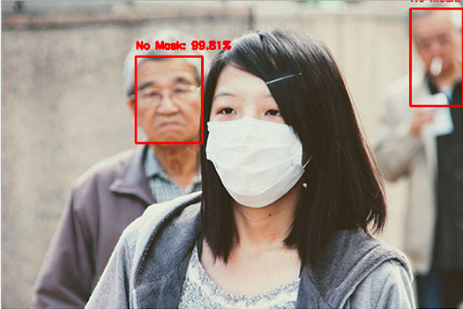
Story – Mask/No-Mask Detector
Real time detection of masks/no masks
Collecting custom datasets
Data pre-processing and dealing with small datasets
Testing out various algorithms to narrow down the most accurate one
Result interpretation & Hyperparameter tuning

Slide 6
Introduction to Convolutional Neural Networks
What are Neural Nets?
Notes:
Server deployment and configuration

Slide 7
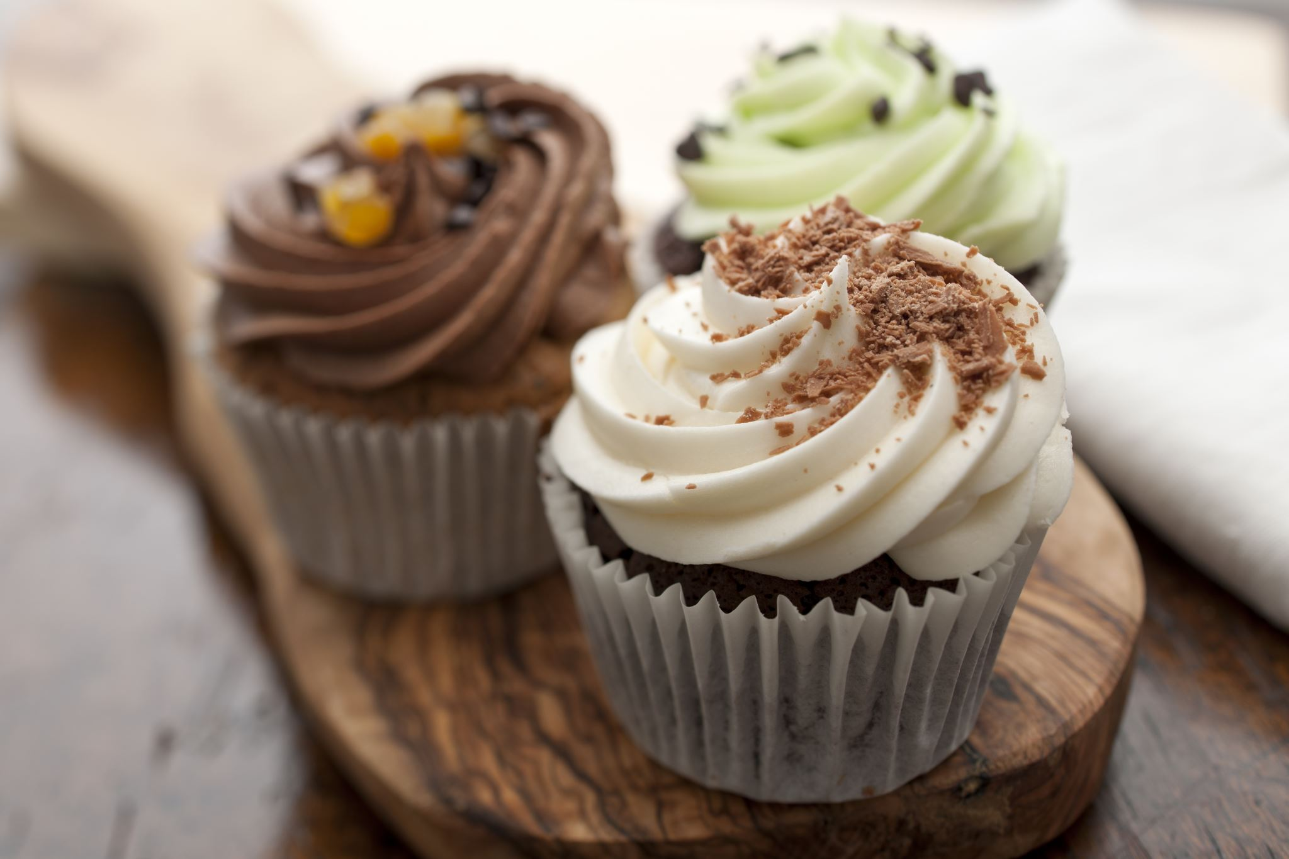

NEURAL NETWORKS
Destination (x_1, y_1)
A
Curr_pos (x_0, y_0)
D
E
B
F
C
G

Slide 8

NEURAL NETWORKS
INSTRUCTIONS
Go forward for 20m
Turn 90 degrees left
Go forward 10m

Slide 9
Problem Not generalizable/scalable to wide range of scenarios
NEURAL NETWORKS

Slide 10

NEURAL NETWORKS
Curr_pos (x_0, y_0)
A
B
C
D
D
E
F
Destination (x_1, y_1)

Slide 11
GRADIENT DESCENT
NEURAL NETWORKS
Intuition – Descending down the mountain
Gradient = derivative of the cost function
Descent = Traverse in the direction of the steepest decrease in gradient
Solution to cup-cake problem: Minimize the distance to the cake
Solution to mountain problem: Minimize the distance to the ground
Solution to any problem (Autonomous navigation, image classification, playing chess) : Minimize the error between current state and solution state

Slide 12
NEURAL NETWORKS
NEURAL NETWORKS
The Basis of Deep Learning

Slide 13
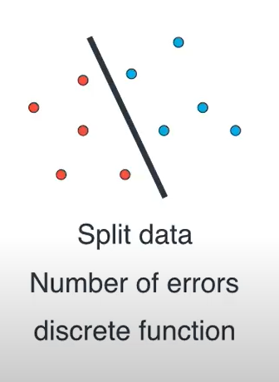
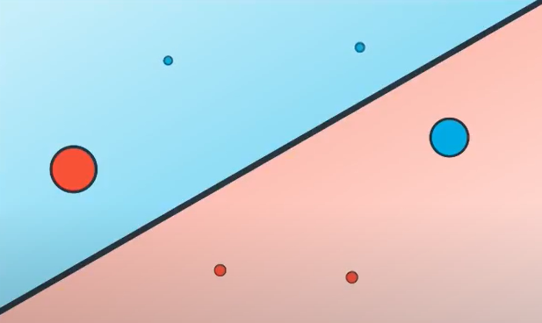

LOGISTIC REGRESSION
Penalties: CONTINUOUS
DISCRETE
ERROR = f ( PENALITIES) → Error becomes continuous

Slide 14
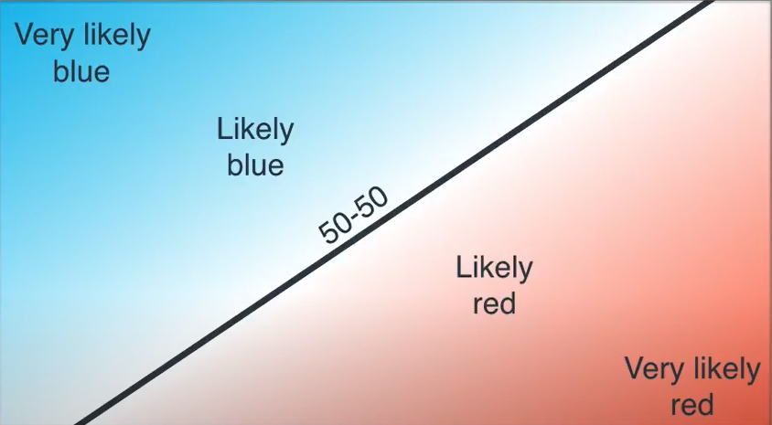
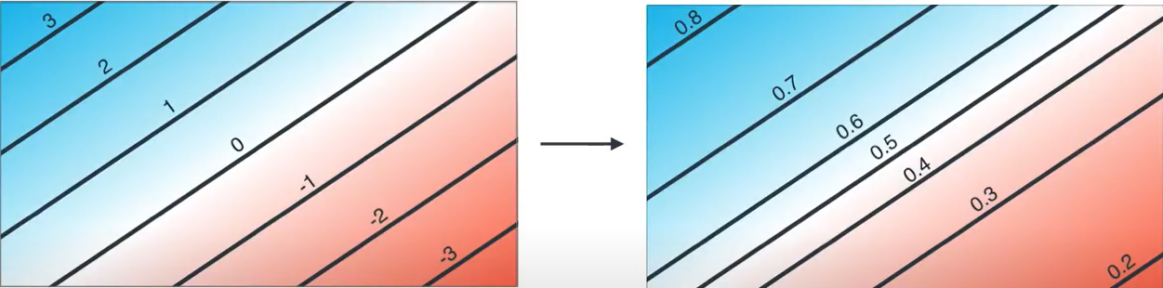
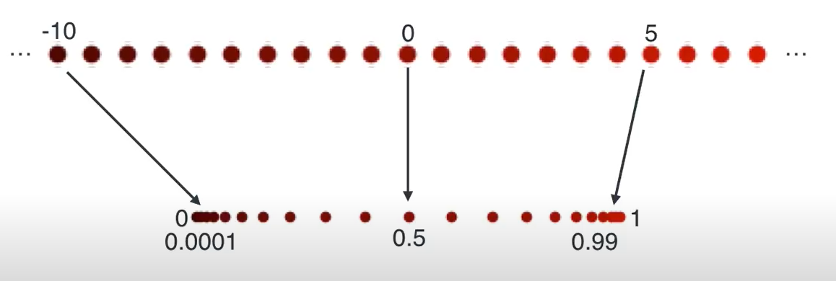
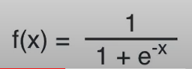
NEURAL NETWORKS
ACTIVATION FUNCTION
SIGMOID ACTIVATION FUNCTION

Slide 15
POPULAR ACTIVATION FUNCTIONS
Sigmoid Activation Function
Hyperbolic Tangent Activation Function (tanh)
Rectified Linear Unit (ReLU): Popular in CNNs

Slide 16
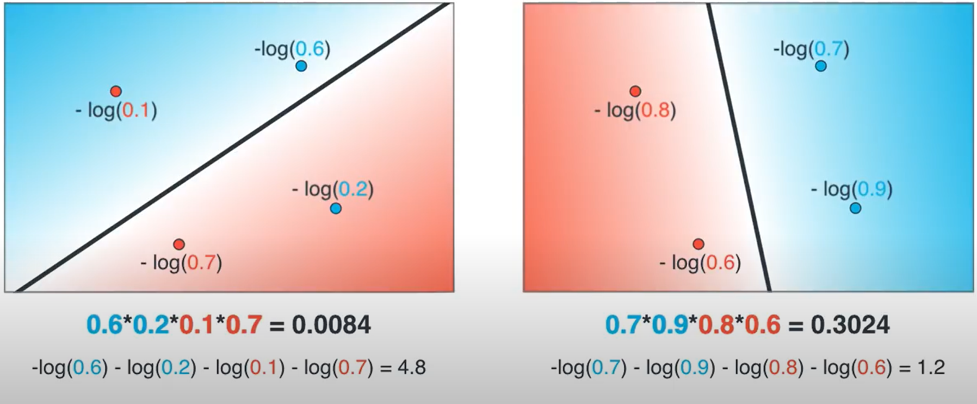
ERROR FUNCTION
NEURAL NETWORKS

Slide 17

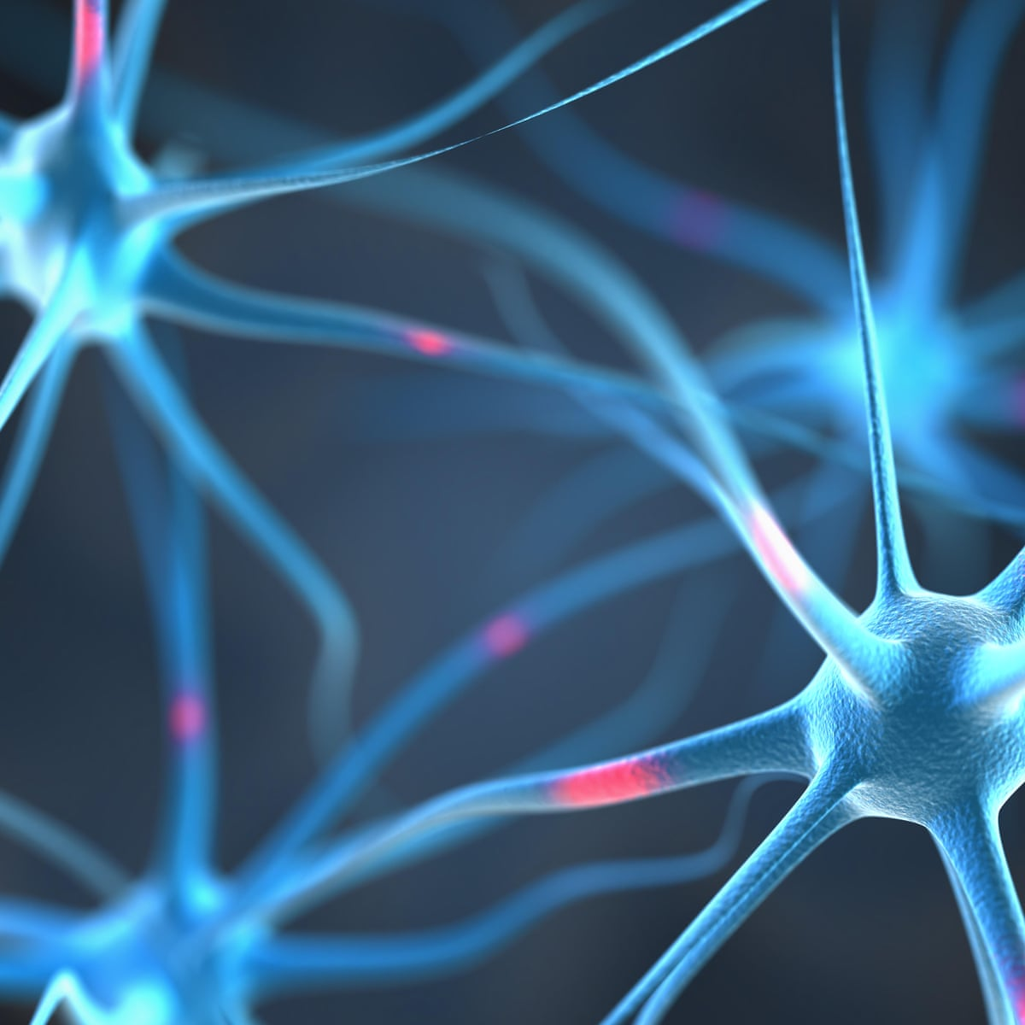
NEURAL NETWORKS

Slide 18
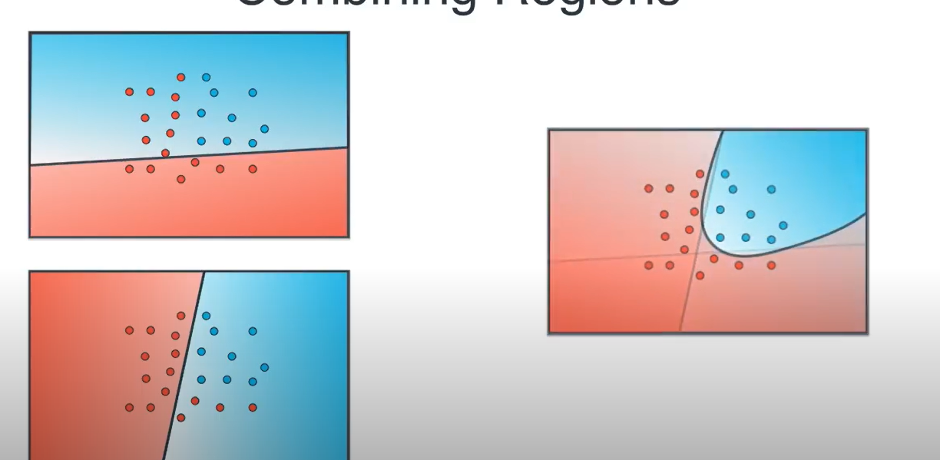
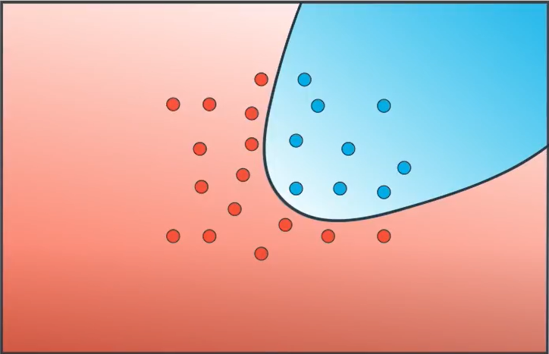
NEURAL NETWORKS
More complex problem…

Slide 19
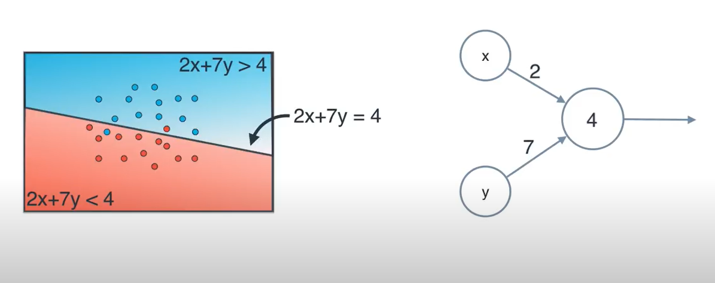
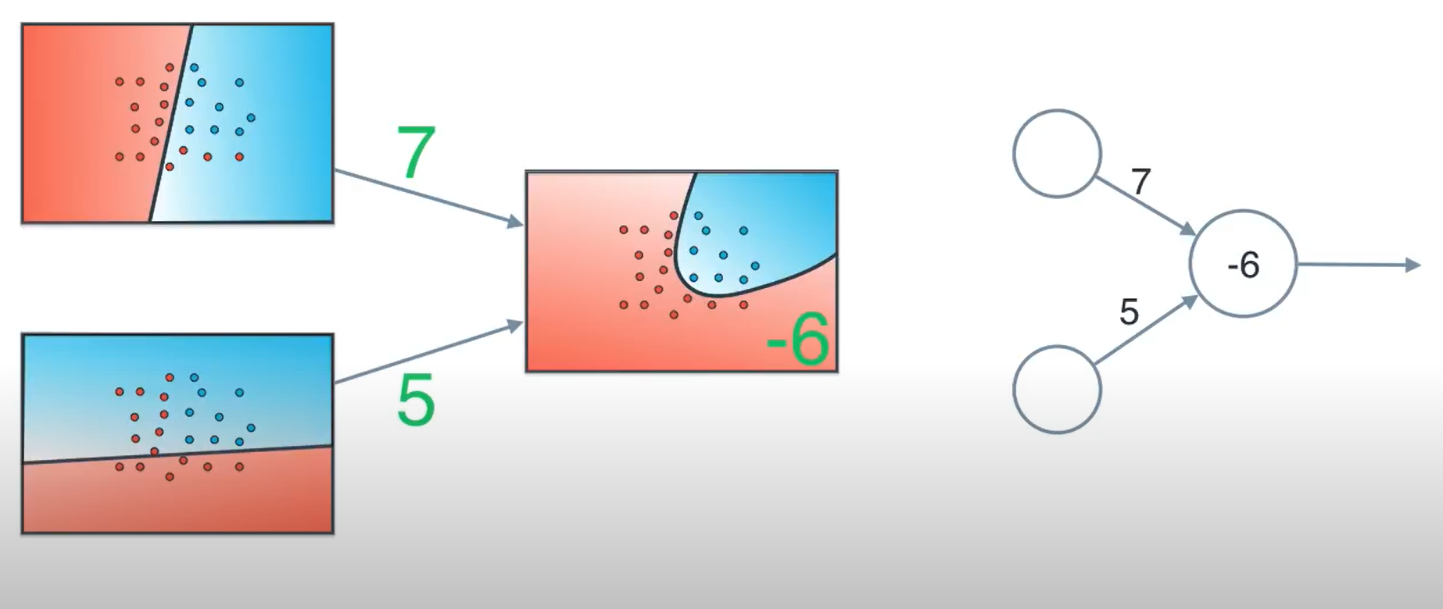
NEURAL NETWORK
NEURAL NETWORKS
+
Breaking down a larger problem into more simpler ones & superimposing their results
Notation for the output from a neural network: Z^{[1]} = W^{[1]} a ^{[0]} + b^{[1]}
Z ^{[1]} is called the summed activation, which is then transformed by an activation function
In the above example, W = 7,5 ; a = 4; b = -6

Slide 20
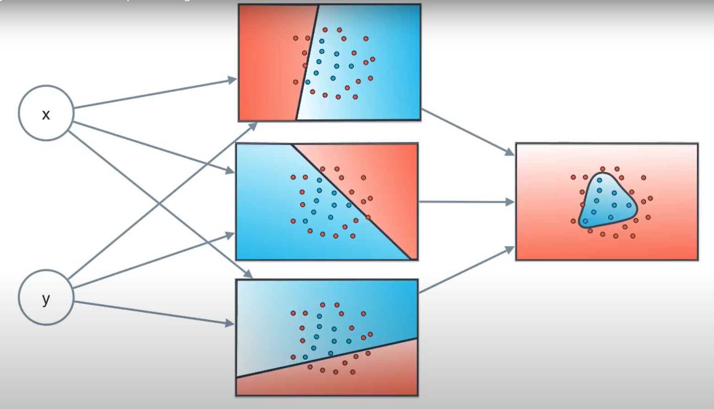
NEURAL NETWORKS
INPUT LAYER
HIDDEN LAYER
OUTPUT LAYER

Slide 21
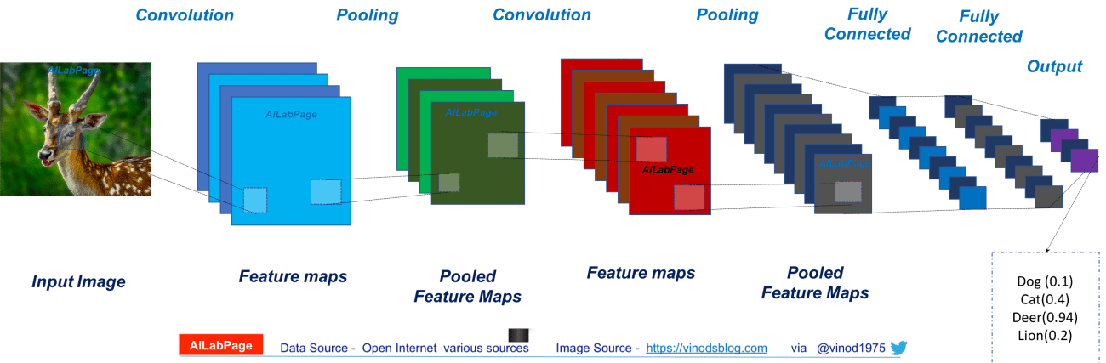
NEURAL NETWORKS
NEURAL NETWORK

Slide 22
COMPUTER VISION PROBLEMS
TYPES OF CV PROBLEMS

Slide 23
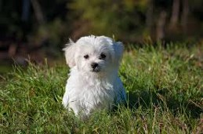
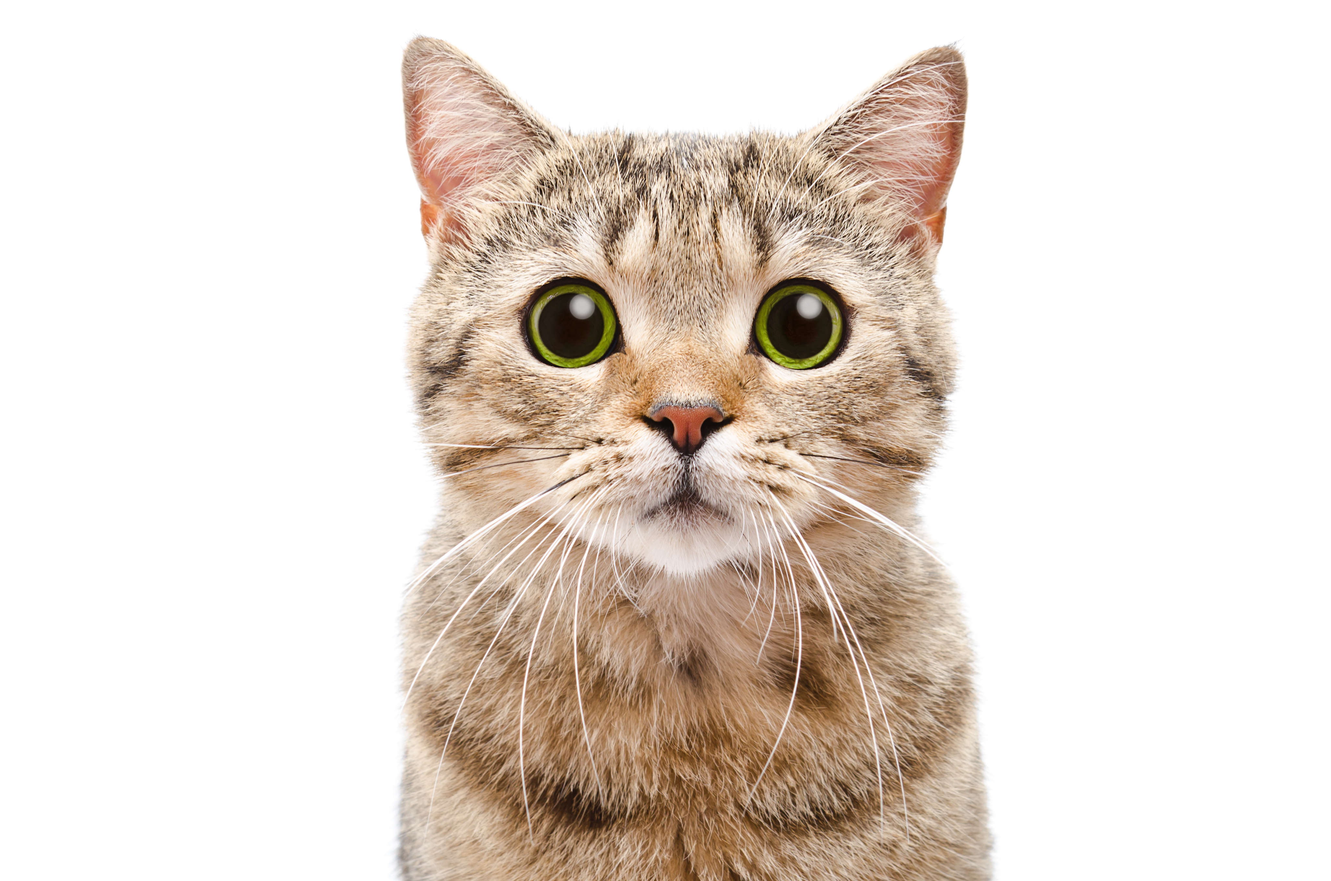
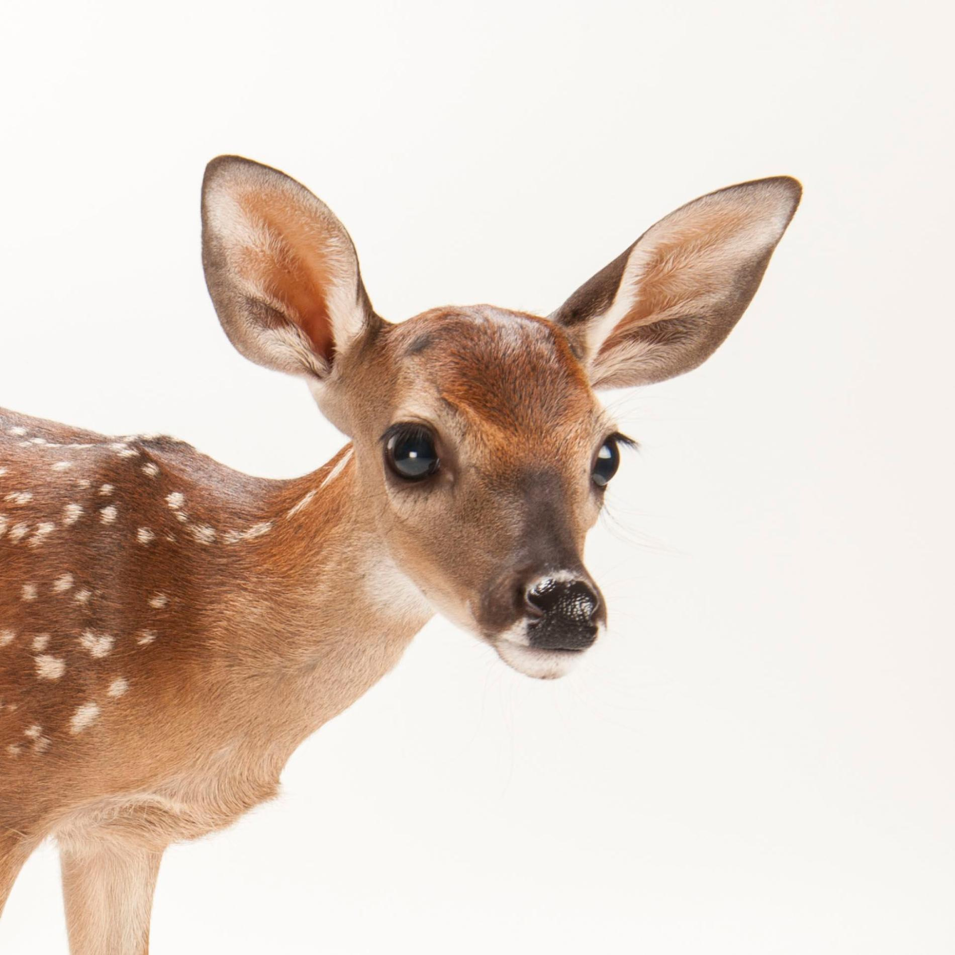
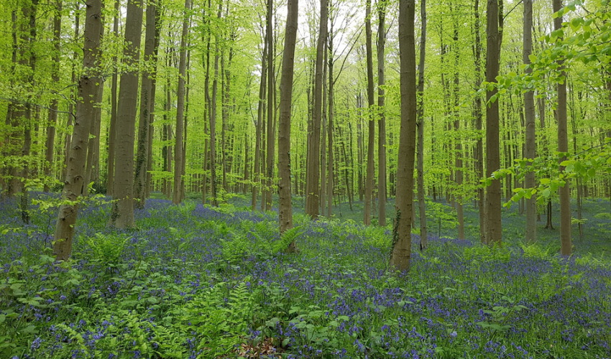
IMAGE CLASSIFICATION
TYPES OF CV PROBLEMS
Class 0: Background
Class 1: Dog
Class 2: Cat
Class 3: Deer

Slide 24
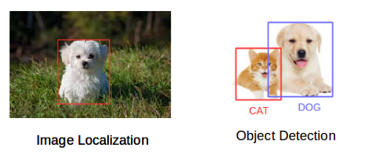
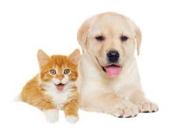
IMAGE LOCALIZATION & OBJECT DETECTION
TYPES OF CV PROBLEMS

Slide 25
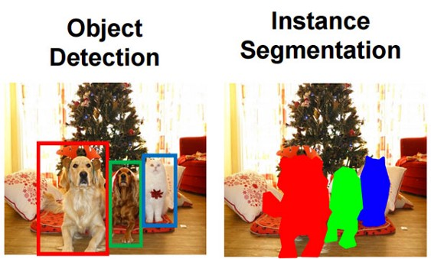
IMAGE SEGMENTATION
TYPES OF CV PROBLEMS
Divide or partition the image into various parts called segments
Allows us to consider only the important parts of an image (region proposals)
Group pixels together that have common properties

Slide 26
SUMMARY
TYPES OF CV PROBLEMS
Image Classification: Classify what is contained in an image (e.g., cat, dog, person, truck, car)
Image Localization: Provide the exact location of a particular object in an image
Object Detection: Provide the exact locations of multiple objects in an image (you cannot infer the shape of an object, only its location)
Image Segmentation: Create a pixel-wise mask for each object in an image (you can infer the shape of the object)

Slide 27
CONVOLUTIONAL NEURAL NETOWORKS
INTRODUCTION TO CNNs
The revolutionary technique dominating computer vision applications

Slide 28
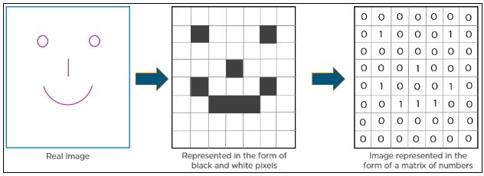
How do computers see images?
INTRODUCTION TO CNNs

Slide 29
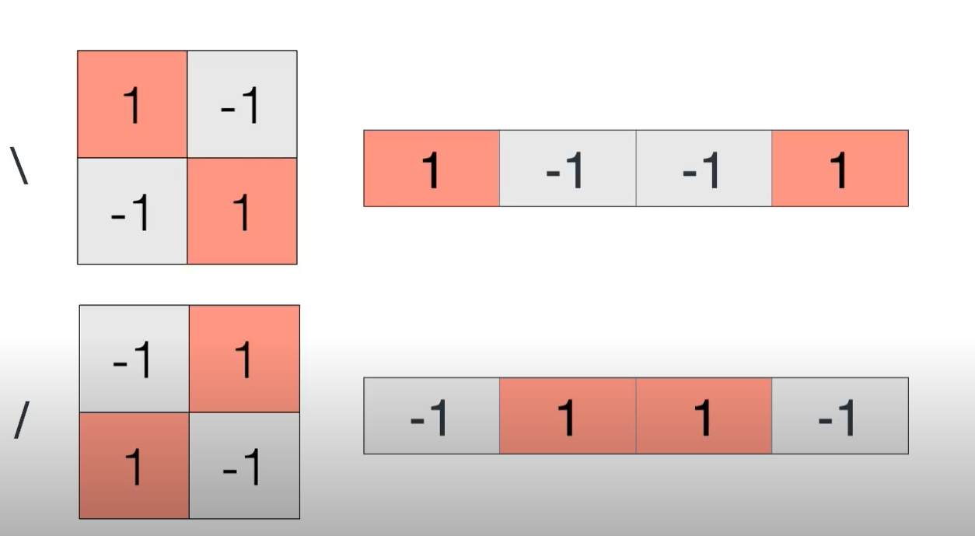
INTRODUCTION TO CNNs

Slide 30
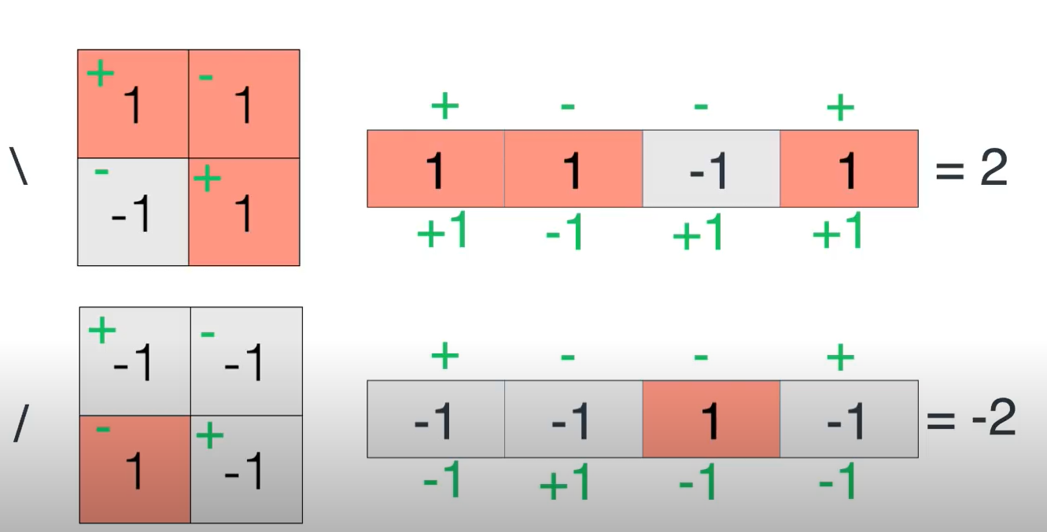
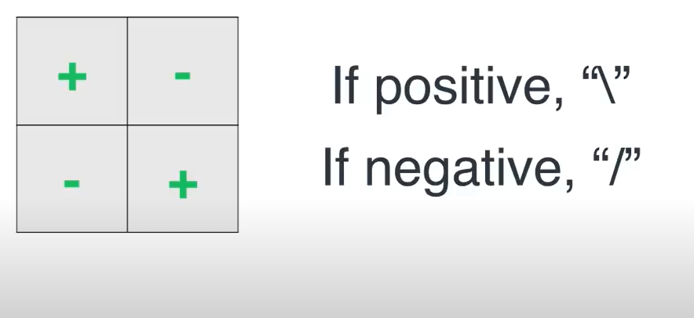
How do you classify “/” and “\”?
INTRODUCTION TO CNNs
The above operation is one among many possibilities that could have been used. The key is to solve the problem of finding these operations to detect features in an image

Slide 31
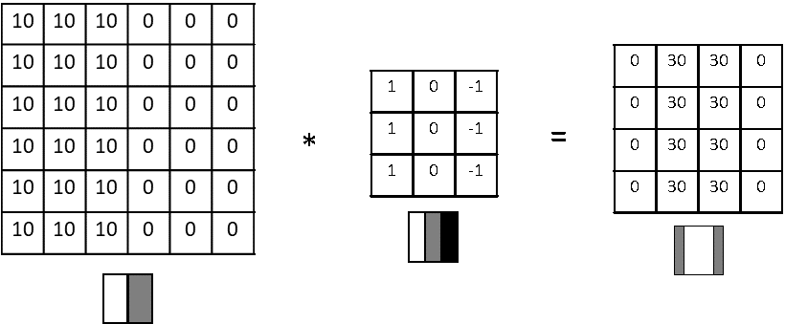
INTRODUCTION TO CNNs
WHAT ARE CONVOLUTIONS?
INPUT IMAGE
KERNEL
CONVOLVED IMAGE

Slide 32
INTRODUCTION TO CNNs
WHY CONVOLUTIONS?
Inputs can be really big, especially for higher resolution images.
This will increase the number of parameters in the hidden layers
it will be difficult to get that much data to prevent the model from overfitting.
To not be stuck using very small images, we need to perform convolution.

Slide 33

INTRODUCTION TO CNNs
HOW TO PERFROM CONVOLUTIONS?
NOTE: Image shrinks after convolution

Slide 34
HOW TO PERFROM CONVOLUTIONS?
When an nxn image is convolved with a fxf filter, the resulting image will have the dimensions
(n-f+1)x(n-f+1)
By convention, f is always an odd number.
By having a pixel with an odd dimensionality, we have a central pixel in the image using which the position of the filter can be easily determined

Slide 35
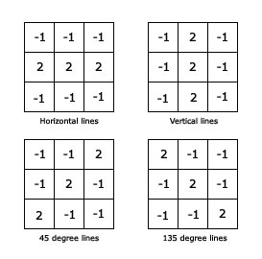
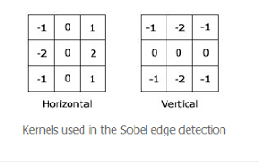
INTRODUCTION TO CNNs
NEED FOR CNNs
These kernels work for simple features like edges
What about for more complicated features like the eyes of a person? How do you define a kernel that can find these features? We need “LEARN” these features automatically

Slide 36
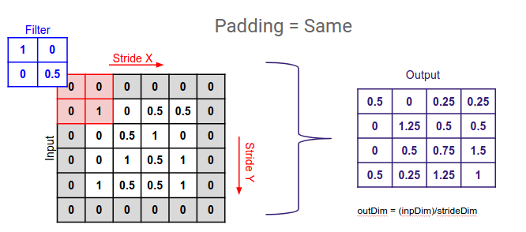
PADDING

Slide 37
PADDING
INTRODUCTION TO CNNs
After convolution, the image shrinks. So, we can’t use this operator multiple times as it would converge to 1x1.
The filter overlaps many more times with central pixels than with those at the corners.
Pixels at the edges aren’t used as much for convolution as the pixels in the centre.
We can add padded layers so as to ensure that the image output after adding convolution is the same as the input image.
There are two types of convolutions – valid convolutions and same convolutions.
In valid convolutions the output size of the resulting image becomes – (n-f+1) x (n-f+1)
In same convolutions, the output size is the same as the input size, i.e., n.

Slide 38

STRIDED CONVOLUTIONS
In strided convolution, we stride over ‘s’ nodes while convolving as shown in the example below:

Slide 39
STRIDED CONVOLUTIONS
The resulting dimension of the output combining padding and striding is given by:
((n + 2p -f)/s)+1
In case the above computation doesn’t result in an integer, then the result is rounded down by convention.
Convolving in 3 dimensions will need to be carried out for RGB images. The filter thus will be 3x3x3 and not 3x3. The last (3) denoting the number of channels.

Slide 40
ONE LAYER OF A CNN
RECALL: The standard form of the output of a neural network will look like:
Z^{[1]} = W^{[1]} a ^{[0]} + b^{[1]}
a ^{[1]} = g(z^{[1]}), where g is a function which introduces some non-linearity in the output. G can be the sigmoid function as mentioned before.
The output of the convolution is added with a bias and then ReLU (a non-linearity) is applied on it to get the output of the Conv layer.

Slide 41
Why is ReLU preferred over Sigmoid/Tanh?
A general problem with both the sigmoid and tanh functions is that they saturate.
This means that large values snap to 1.0 and small values snap to -1 or 0 for tanh and sigmoid respectively.
Once saturated, it becomes challenging for the learning algorithm to continue to adapt the weights to improve the performance of the model: Information eventually degreades
Layers deep in large networks using these nonlinear activation functions fail to receive useful gradient information.
The change in error with each additional layer fails to reduce – this is called the vanishing gradient problem

Slide 42
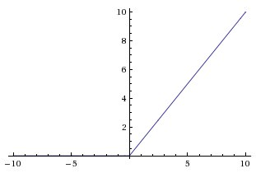
Why is ReLU preferred over Sigmoid/Tanh?
Adoption of ReLU is one of the few milestones in the deep learning revolution
A node or unit that implements this activation function is referred to as a rectified linear activation unit, or ReLU for short
ReLU is much simpler to compute than sigmoid/tanh
Neural networks are easier to optimize if the behavior is approximately linear
Overcomes the vanishing gradient problem, allowing deeper networks to be trained

Slide 43
TYPICAL ARCHITECTURE OF CNNs
What are common features of popular CNNs?

Slide 44
Pooling Layers
Why are they used?

Slide 45
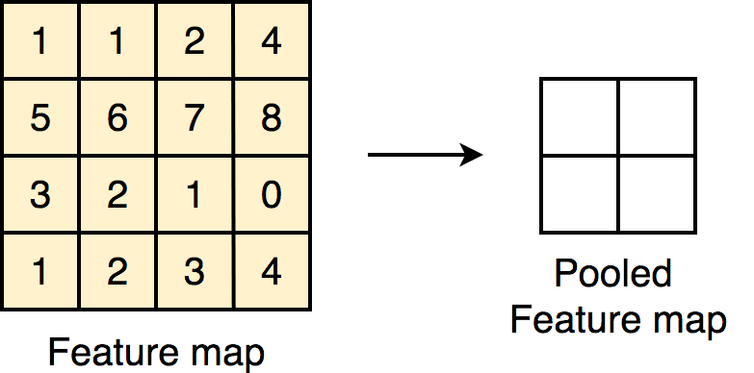
Why Pooling?
Pooling layers are used to reduce the size of the representation to speed up computation as well as to make feature detection more robust.
Two types of pooling: Max pooling & average pooling (not used much anymore)

Slide 46
What is max pooling?
In Max pooling, the maximum value in the region of consideration is taken (which depends on the size of the hyperparameter ‘f’ chosen).
Since both f and s are chosen beforehand, there is nothing to be learnt.
If input is 2D, output will also be 2D. If input is 3D, so will be the output.
The size of the output can be determined using the same formula we used for convolution, i.e., output size = n+2p-f/s +1
Similarly, average pooling will calculate the average of the given region of consideration of the input.

Slide 47
Fully Connected Layers
The layers that make sense of everything

Slide 48
What is the function of FC layers?
Fully connected layers do the job of actually producing the output required from the activations obtained thus far
For example, a fully connected layer is the one which computes the probabilities that the object belongs to one of ‘n’ classes in a classification problem
It is also responsible for returning the coordinates of the object in a localization or detection problem
A flattened row vector is computed prior to being evaluated by an FC layer
In an FC layer, each neuron of the input is connected to the output fully

Slide 49
Example of a CNN
INPUT LAYER
CONV1
CONV2
CONV3
Flatten
1960 x 1
Size of 39x39x3
10x 3x3 Filters
Stride(s) = 1
Padding (p) = 0
Output = (39 + 2x0 – 3)/1 +1 = 37
37 x 37 x 10
20x 5x5 Filters
Stride(s) = 2
Padding (p) = 0
Output = (37 + 2x0 – 5)/2 +1 = 17
17 x 17 x 20
40x 5x5 Filters
Stride(s) = 2
Padding (p) = 0
Output = → (17 + 2x0 – 5)/2 +1 = 7
7 x 7 x 40
FC
OUTPUT
NOTE: Remember that as you go deeper into a neural network, the height and width of the image will decrease and the number of channels (n_{c}) will increase.

Slide 50
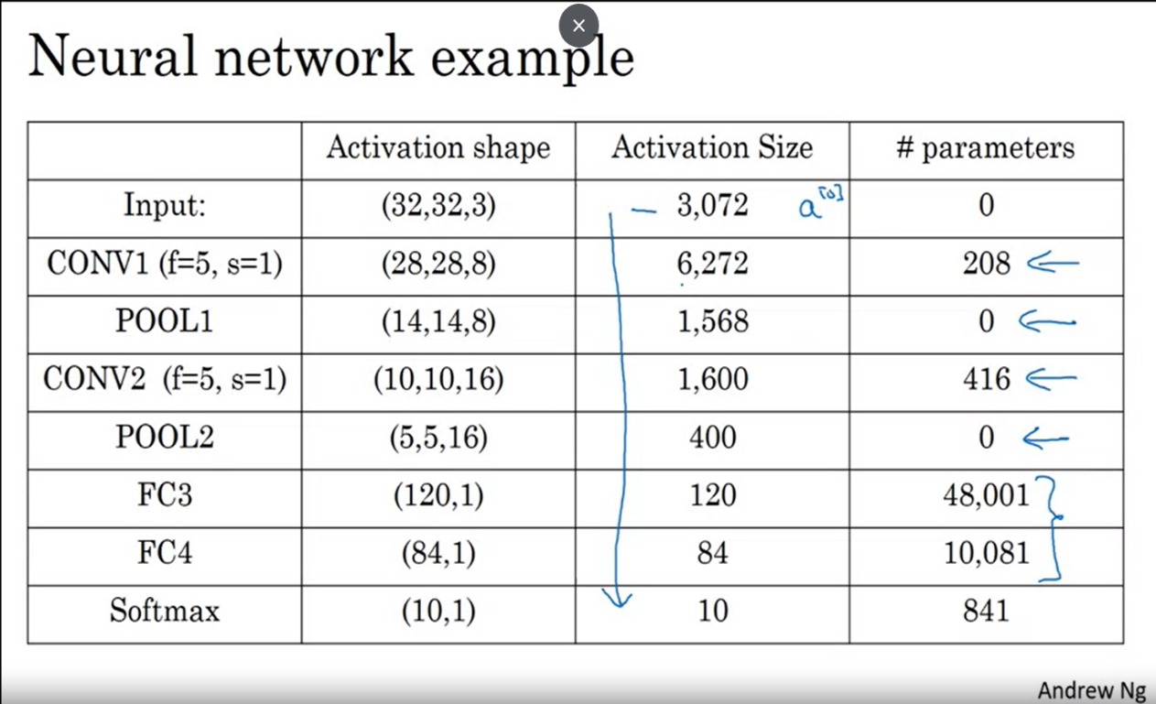
PARAMETER SHARING
The no. of parameters to be learned for CONV layers is least and reduces as we go deeper in the network
Parameter sharing: Suppose you have a vertical edge detection kernel. The same kernel can be used to detect vertical edges in different parts of the same image. We don’t need a new vertical edge detector for different parts of the same image means you can share features learned

Slide 51
ARCHITECTURES OF POPULAR CNNs

Slide 52
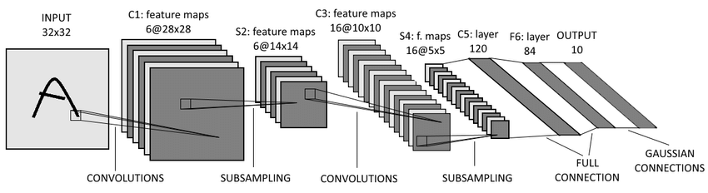
LeNet-5
Goal was to recognize handwritten digits within input image having dimensions 32x32x1
Padding wasn’t used, and hence the image keeps shrinking with each convolution
Output node with 10 features, each corresponding to a digit from 0-9
This network had 60,000 parameters, which by today’s standards is quite small. Today we have up to 10 million parameters in a network. Activation Function used : Sigmoid
An interesting observation is that most networks have the following arrangements: conv → pool → conv → pool → fc → fc → output (usually softmax)

Slide 53
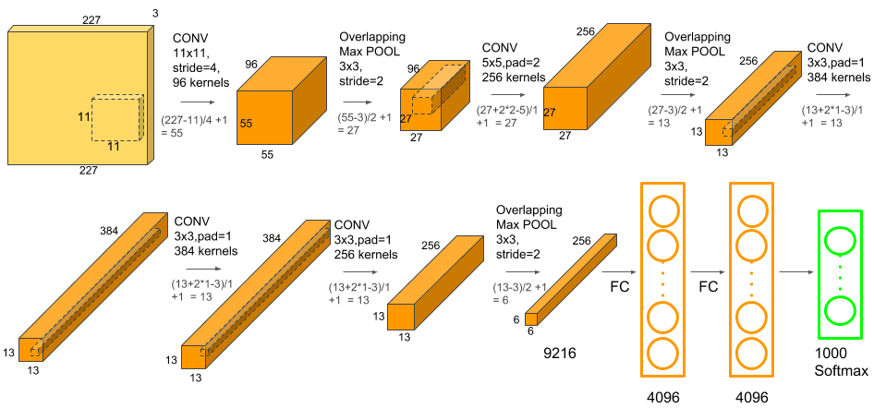
AlexNet
AlexNet is named after the original first author of the paper that introduced this architecture.
Won ImageNet challenge 2012. At the time of this paper, GPUs weren’t very powerful, so they devised a method to train nearly 60 million parameters of AlexNet with two GPUs communicating with each other

Slide 54
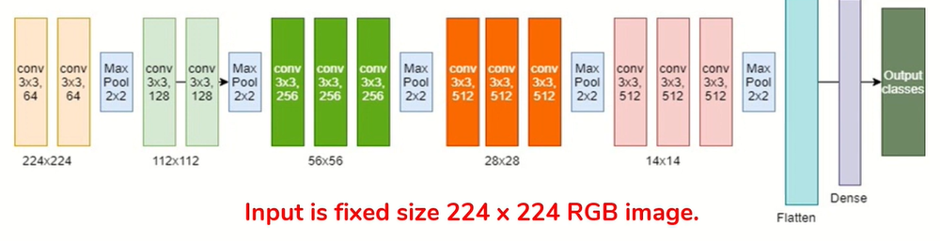
VGG-16
16 Layers deep
Uniform architecture
138M parameters to train

Slide 55
DISADVANTAGES OF CNNs
Large Datasets: For novel problems, huge amounts of data is required for each class
Class Imbalance: Not having same number of images for each class
Data sparsity: Difficult to find sufficient images for certain applications
Large training time: Consumes a large amount of computational power for training
Overfitting: Especially with smaller datasets, it tends to learn irrelevant details & overfits
Experience needed for hyperparameter tuning

Slide 56
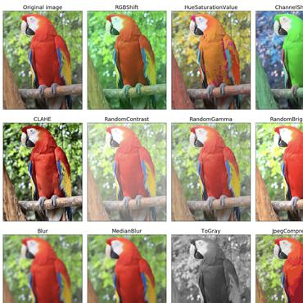
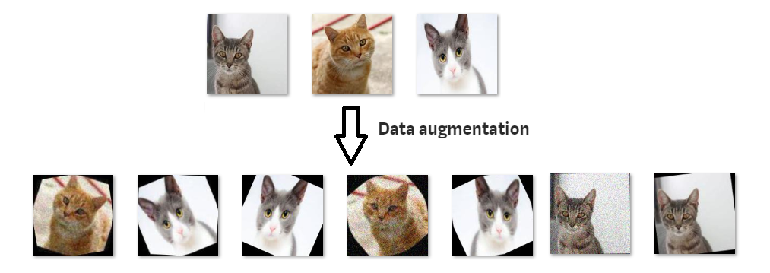
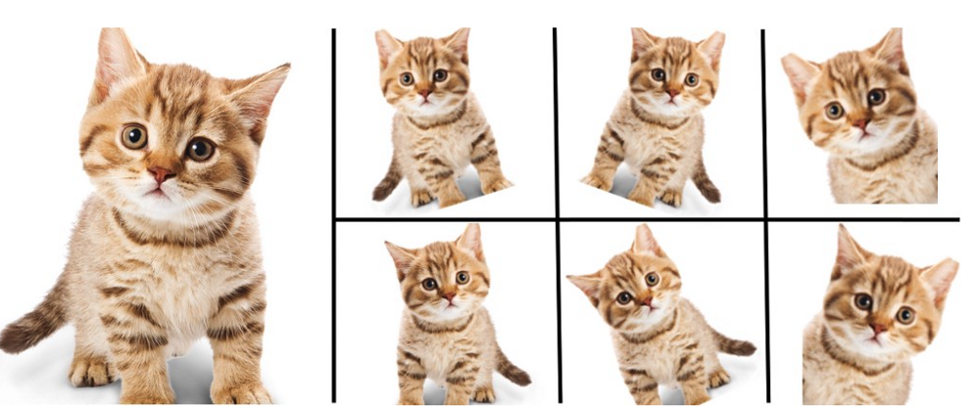
OVERCOMING OVERFITTING & UNBALANCED DATASETS DATA AUGMENTATION

Slide 57
TRANSFER LEARNING
The solution to large datasets issue

Slide 58
WHAT IS TRANSFER LEARNING?
Using pre-trained networks and applying to your problems
Re-using the parameters learned from a different problem
For example, take a classifier for dogs and use its learned parameters to classify cats with minimal training data
Most networks are trained on ImageNet (14M images) – highly transferrable to other tasks

Slide 59
How to perform transfer learning?
Remove the FC layers of an already trained model and replace with your own
Only train the parameters of the FC layer you added
Retain the trained parameters of all the other layers
Works best if the data in the new task is similar to that of the old task
Drastically reduced training time
Lower training rate by an order of magnitude when training with new data
Edges, textures, patterns learned from one dataset can be applied to another
These are called generic feature extractors
As you go deeper in the network, the features would be more & more specific

Slide 60
MATLAB Functions Used
A summary of the commonly used functions for image classification

Slide 61
MATLAB Functions for Image Classification
1. imageDatastore
Syntax: imds = imageDatastore(location)
Use an ImageDatastore object to manage a collection of image files, where each individual image fits in memory, but the entire collection of images does not necessarily fit.
Arguments: IncludeSubFolder, LabelSource
2. splitEachLabel
Syntax: [imds1,...,imdsM] = splitEachLabel(imds,p1,...,pN)
Split imageDatastore labels by proportion

Slide 62
MATLAB Functions for Image Classification
3. augmentedImageDatastore
Syntax: auimds = augmentedImageDatastore(outputSize,imds)
An augmented image datastore transforms batches of training, validation, test, and prediction data, with optional preprocessing such as resizing, rotation, and reflection.
Resize images to make them compatible with the input size of your deep learning network.
Augment training image data with randomized preprocessing operations to help prevent the network from overfitting and memorizing the exact details of the training images

